Slide 1
WEEK12 LAB
使用malloc/calloc等函数为数组动态分配内存，记得free。
Use functions like malloc/calloc to dynamically allocate memory for arrays, remember to free.
动态分配一维数组的典型方式如下：
A typical way to dynamically allocate a one-dimensional array is as follows:
int n = 100;
char *name; // 创建指针 Create pointer
name = (char *)malloc(sizeof(char)*n); // 为指针分配内存 Allocate memory for Pointers
随后，你可以通过指针或常规方式来索引元素
You can then index the element either by pointer or by general means
*(name + i)
name[i]

Slide 2
实际上，你可以动态创建任意维度的数组。以二维数组为例。
In fact, you can dynamically create arrays of any dimension. Consider a two-dimensional array.
我们需要先创建一个二维指针，包含m个一维指针。
We need to create a two-dimensional pointer with m one-dimensional Pointers.
int **arr = (int **)malloc(sizeof(int*)*m);
随后为其中的每个一维指针分配内存
for(int i = 0; i<m; i++)
{
arr[i] = (int *)malloc(sizeof(int)*n);
}
随后，你可以通过指针或常规方式来索引元素
You can then index the element either by pointer or by general means
*(*(arr+i)+j)
arr[i][j]

Slide 3
1. 编写一个函数sumMatrix，接受一个二维数组以及矩阵的长、宽作为参数，返回矩阵所有元素的和。尝试使用不同形式的参数例如int a[ ][ ], int *a[ ], int **a, int (*a)[ ]。观察哪些可以正确地向函数传递数组。
Write a function, sumMatrix, that takes a two-dimensional array and the length and width of the matrix as arguments, and returns the sum of all the elements of the matrix. Try to use different forms of parameters such as int a[ ][ ], int *a[ ], int **a, int (*a)[ ]. Observe which arrays can be passed to the function correctly.
在实际应用中，一般不会动态分配多维数组，而是只动态分配一维数组，用映射的方式将二维数组映射到一维。例如我们想要定义m x n的二维数组，实际上我们会分配一个大小为m x n的一维数组。
In practical applications, multidimensional arrays are generally not dynamically allocated, but only one-dimensional arrays are dynamically allocated, and two-dimensional arrays are mapped to one dimension by mapping. For example, if we want to define a two-dimensional array of m x n, we would actually allocate a one-dimensional array of size m x n.
arr = (int *)malloc(sizeof(int)*m*n);
随后，根据要索引的元素坐标i和j，以及行数m、列数n，我们可以索引其一维坐标arr[i*n+j]。（取决于你如何映射）
Then, based on the element coordinates i and j to be indexed, and the number of rows m and columns n, we can index its one-dimensional coordinate arr[i*n+j]. (Depends on how you map)

Slide 4
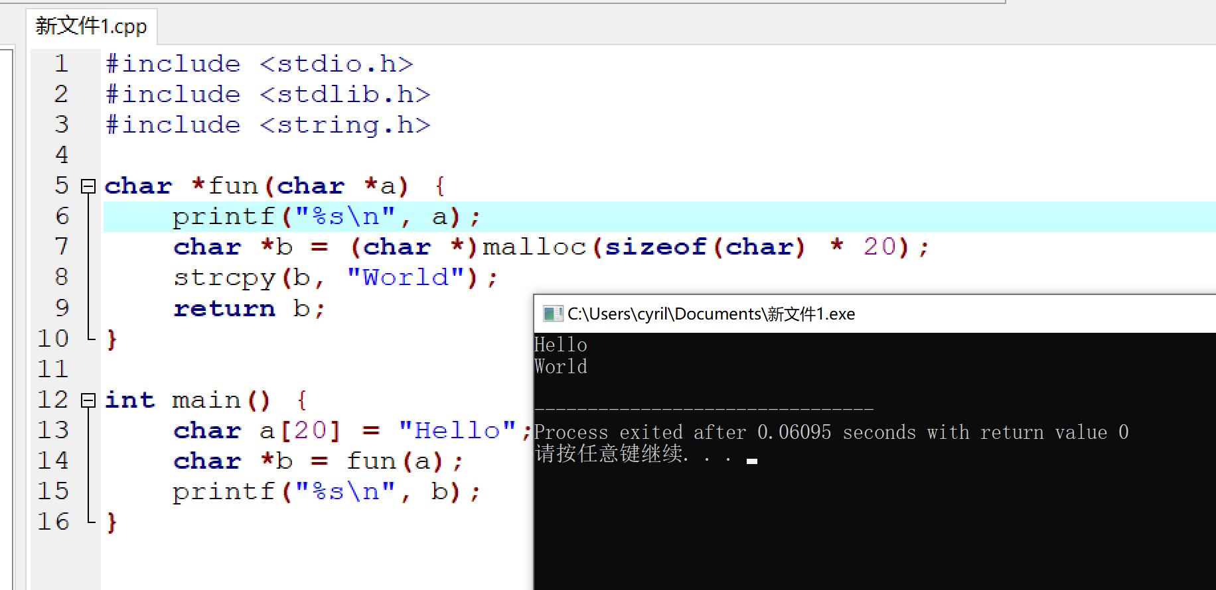
2. 使用二维映射到一维的方式重做第一题，即函数参数为一维数组、行数、列数。
Redo the first question by mapping from two dimensions to one dimension, that is, function parameters are one-dimensional array, number of rows and number of columns.
在函数中，你可以通过return指针来实现返回一个数组。例如你想返回一个字符串，你可以返回这个字符串的指针。（前提是这个指针必须是通过malloc动态分配的内存）
In a function, you can use the return pointer to return an array. For example, if you want to return a string, you can return a pointer to that string. (As long as the pointer is dynamically allocated via malloc)

Slide 5
3. 给定一个非空字符串 s，请判断如果 最多 从字符串中删除一个字符能否得到一个回文字符串。
Given a non-empty string s, determine whether you can get a palindrome string by removing at most one character from the string.

